Slide 1
My experiences developing VSTS extensions
Richard Fennell
Engineering Director, Black Marble

Slide 2
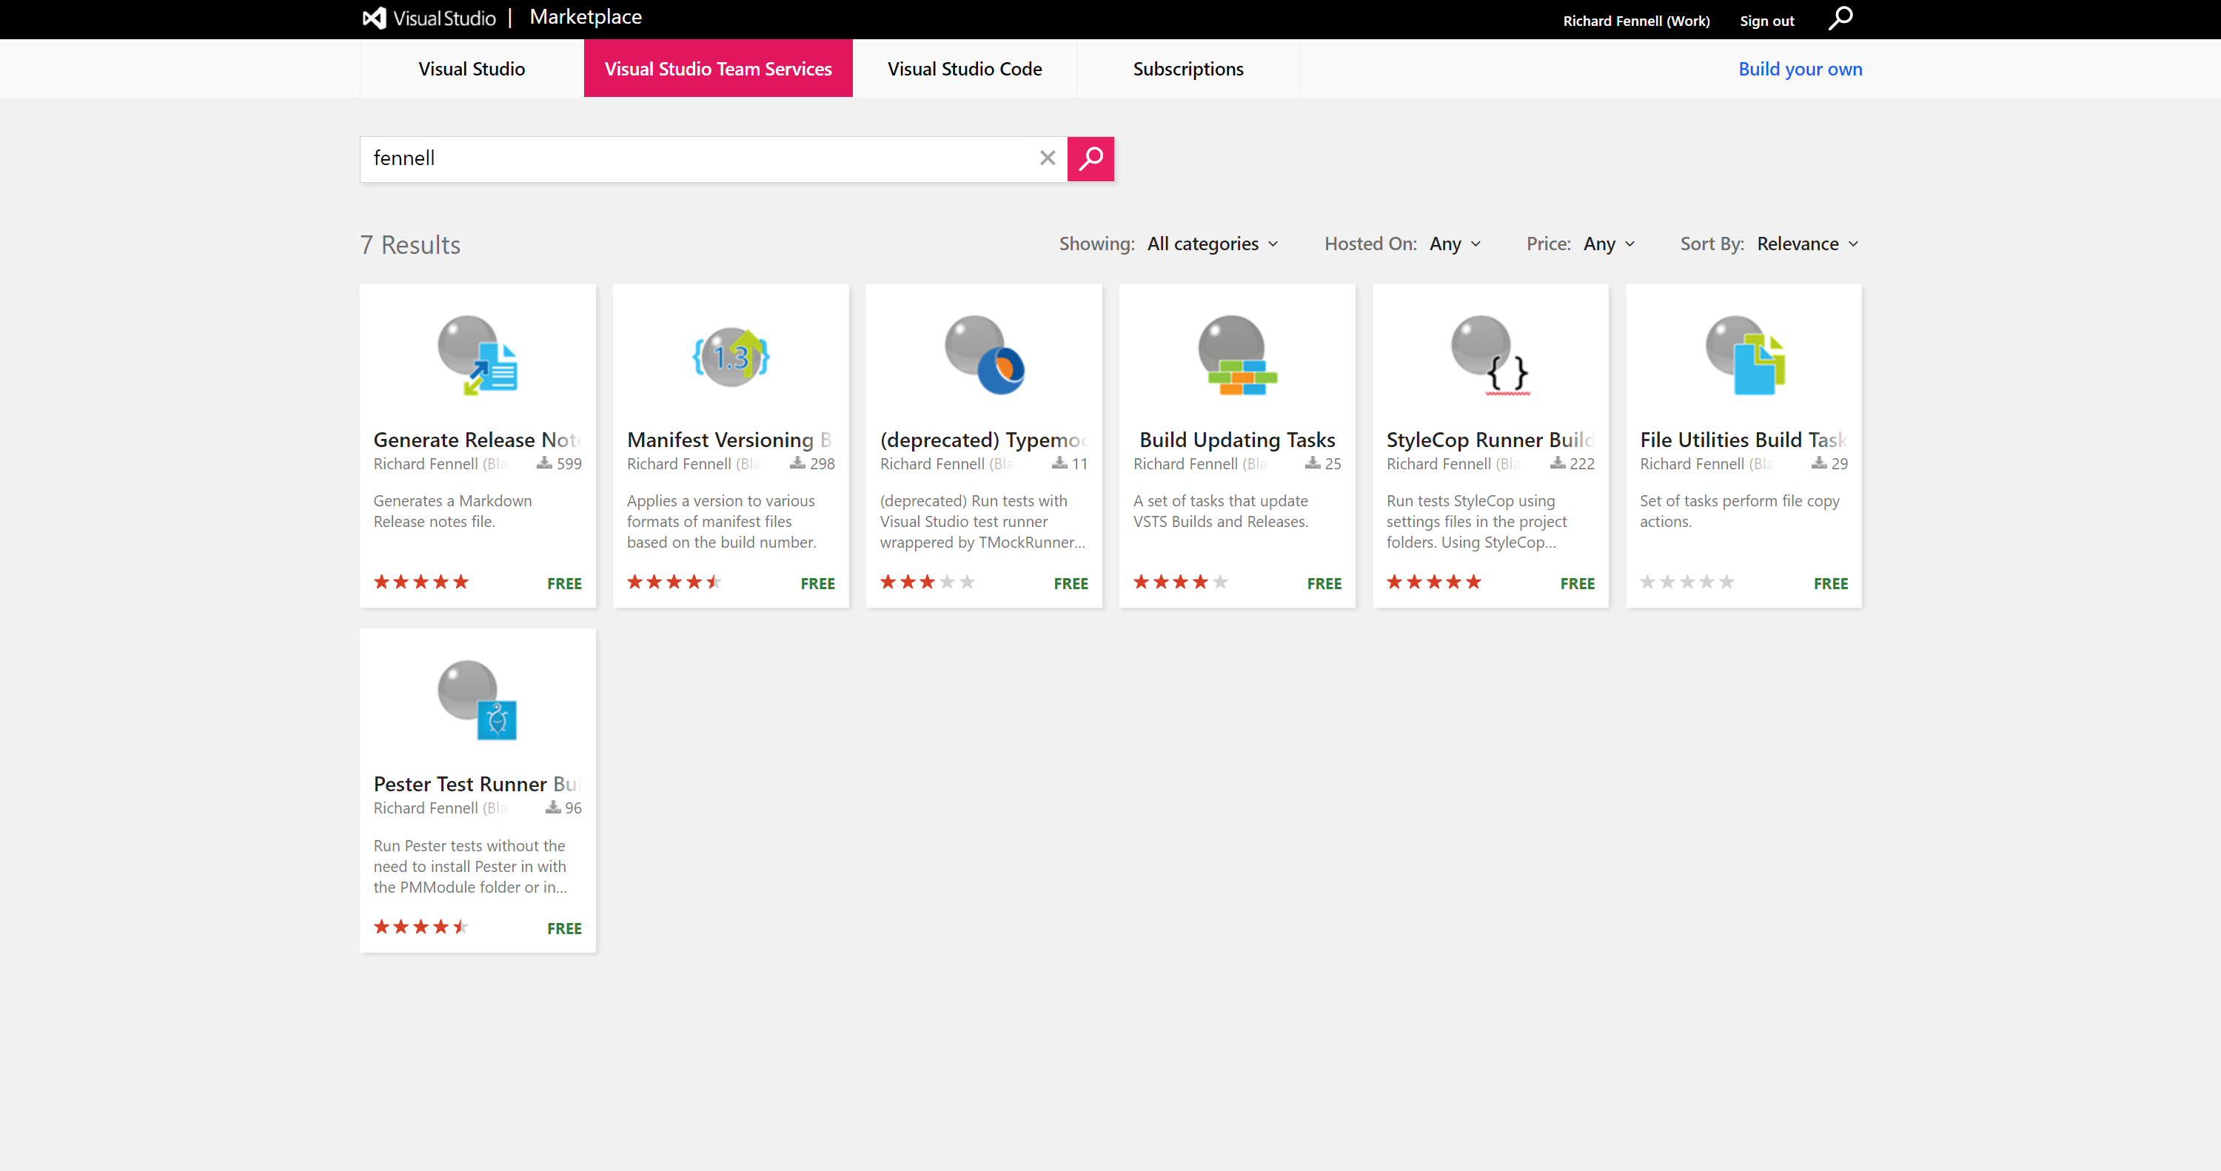
So what have I been doing?
Notes:
Only focused in Windows based build tasks (just started on Node dashboard ones)

Slide 3
Development Tools
Visual Studio Code
Wired F5 to run Pester (launch.json)
{
"version": "0.2.0",
"configurations": [
{
"name": "PowerShell",
"type": "PowerShell",
"request": "launch",
"program": "${workspaceRoot}/Tests/Invoke-Tests.ps1"
// Or to run the current file
// "program": "${file}"
} ]}
GitHub for Source and Issue Tracking
VSTS for Build and Release
Notes:
Did look at Josh’s Visual Studio template, but decided as I was focusing on PowerShell VS a bit heavy weight for me
Using the PowerShell extension
Using Pester as my launch event
Not as easy to use Pester as hoped as much of the process is specific to the build
Also seems to be bug with PowerShell extension and launch (older versions fine)
Using Github for the source (and issue tracking)
A single repo for all extensions – Good idea?
Causes CI issues

Slide 4
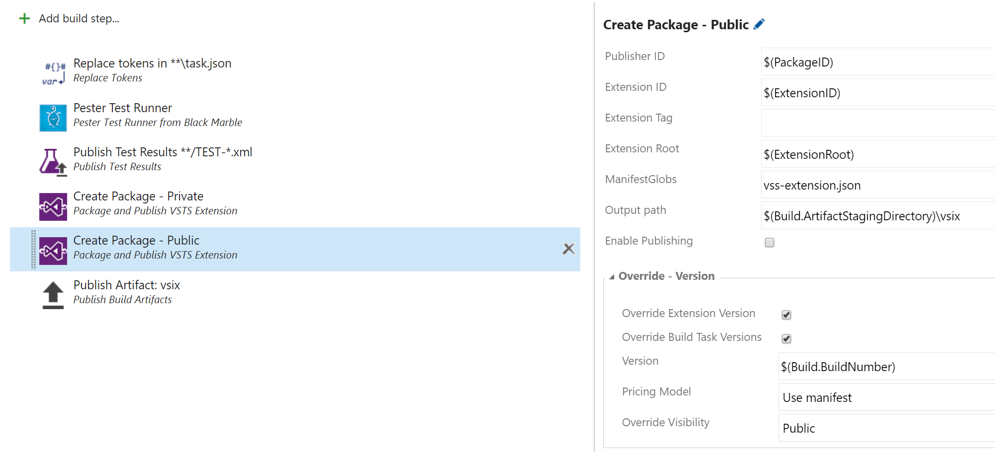
Build Process
Notes:
VSTS for build and release
using Jesse’s VSTS Extension Tasks to do most of the work
Guillaume token task for some token replacement to make sure the version number is on the package ‘more info’ link
Key is we build the package twice
Don’t make use of the preview flag
Note a CI build due to the single Git Repo and no filter for folder in GitHub

Slide 5
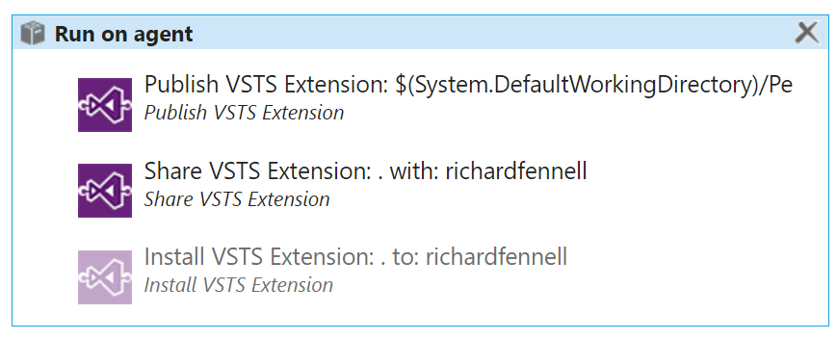
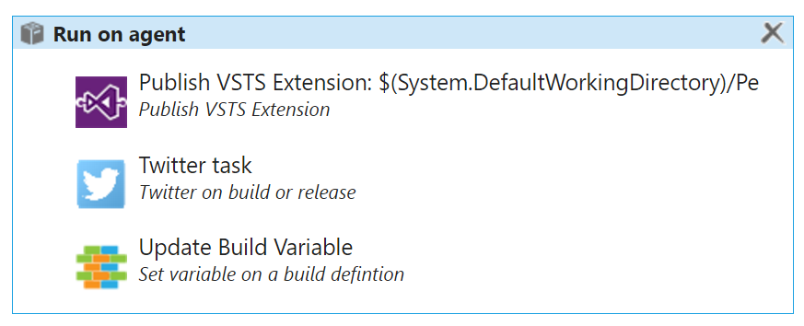
Release Process
‘Private’ Environment
‘Public’ Environment
CI Trigger
Manual Validation
Notes:
Tends to get many private releases for each public one
This means my X.Y.Z build number tend to grow a bit for each formal release
In reality often end up running a local build agent so I ‘hack’ the deployed tasks on the agent to speed the development cycle then check it into the formal dev cycle
The install is commented out as seen some problem re-installing
Could use manual steps in build, just not got around to it
Like to investigate running my validation build, but not done it too much as yet
Public state is a simple publish
Send a twitter (the Xpirit task)
Update my build minor number (so I don’t forget to do this)

Slide 6
Summary
Get your PowerShell working locally as a script first
Can be effective debugging on the build agent
Publish of private extensions can still ‘stall’
Remember you cannot delete a public extension
For more info have a look at
https://github.com/rfennell (vNextBuild repo for the VSTS extensions)
http://blogs.blackmarble.co.uk/blogs/rfennell/
Notes:
Mention the problems I had with deleting a duplicate – this is a support call

Slide 7
Contact
richard@blackmarble.com
@richardfennell
http://blogs.blackmarble.co.uk/blogs/rfennell

